Slide 1
Workshop: Python and OpenCV on Raspberry-Pi Day-3
Introduction to OpenCV on Raspberry Pi
-Prof. Bhaumik Vaidya

Slide 2

What Is Raspberry Pi
Credit-Card sized computer
Developed in U.K by Raspberry Pi foundation in 2009.
Project Initiated By Initiated by Eben Upton.
Based on Broadcom chips.
Affordable Price
Runs LINUX. Microsoft is developing Windows 10 for newer boards.
Consumes less than 5W of Power
Supports Full HD Video Output (1080p), Multiple USB Ports , etc
Notes:
UCCL – University of Cambridge Computer Laboratory
Raspberry Pi 2 Model B Costs $25
And Raspberry Pi Model A+ Costs $20 Indian Price(AMAZON):
Raspberry Pi 2 Model B Costs INR 3,299
And Raspberry Pi Model A+ Costs INR 2,088

Slide 3
History
The Raspberry Pi is the work of the Raspberry Pi Foundation, a charitable organisation.
UK registered charity (No. 1129409), May 2009
It's supported by the University of Cambridge Computer Laboratory and tech firm Broadcomm

Slide 4
Motivation
For Developing CS skills especially in kids.
Limited Access to computers
Computers are the tool of the 21st century
Computer Science is concerned with much more than simply being able to use a computer.
Children should understand how they work and how to program them

Slide 5
Features
Provide a fun environment for experimenting with programming and electronics
Inexpensive, simple, open and easy to maintain computer for schools
Fun computer for children to experiment with at home(programming, robotics, etc...)

Slide 6
Technology
The Raspberry Pi has a Broadcom BCM2835 system on a chip (SoC),which includes an ARM1176JZF-S 700 MHz processor.
Dual Video Core IV GPU.
First model had 256MB RAM, newest has 1GB.
SD card for storage.
Notes:
The ARM1176™ applications processors deployed broadly in devices ranging from smart phones to digital TV's to eReaders, delivering media and browser performance, a secure computing environment, and performance up to 1GHz in low cost designs. The ARM1176JZ-S processor features ARM TrustZone® technology for secure applications and ARM Jazelle® technology for efficient embedded Java execution.

Slide 7
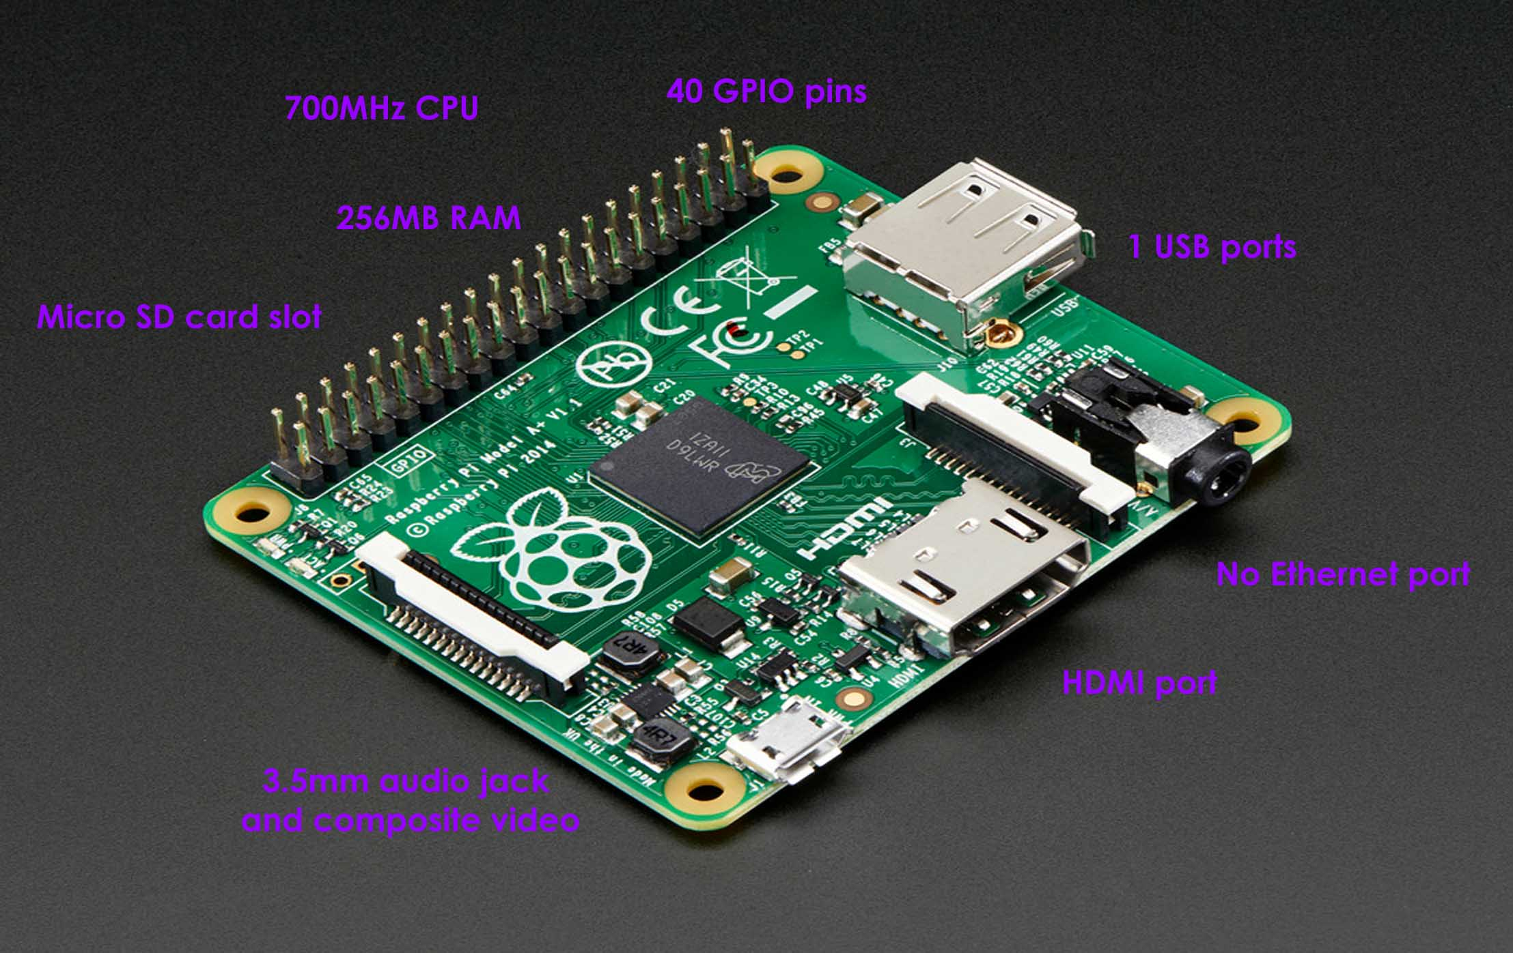
Raspberry Pi A+

Slide 8
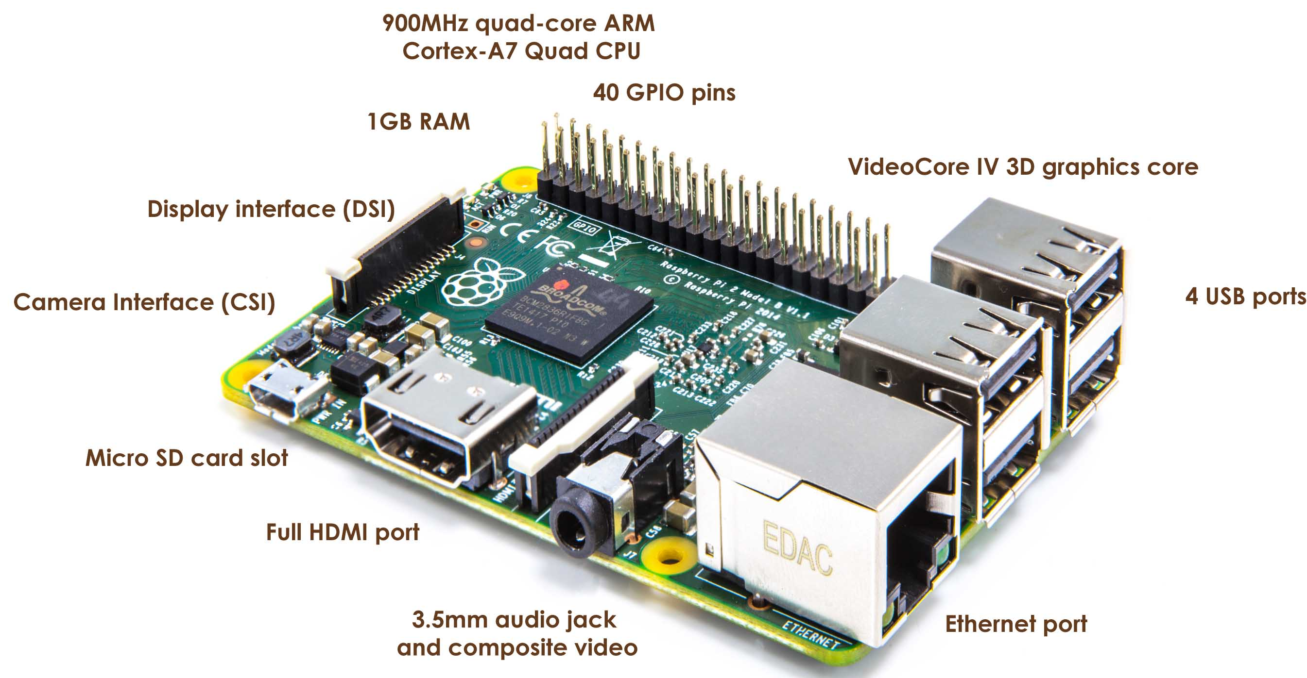
Raspberry Pi 2 Model B

Slide 9
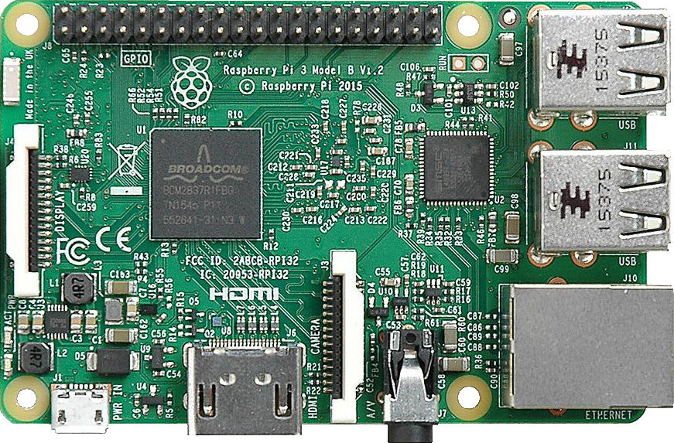
Raspberry Pi 3

Slide 10
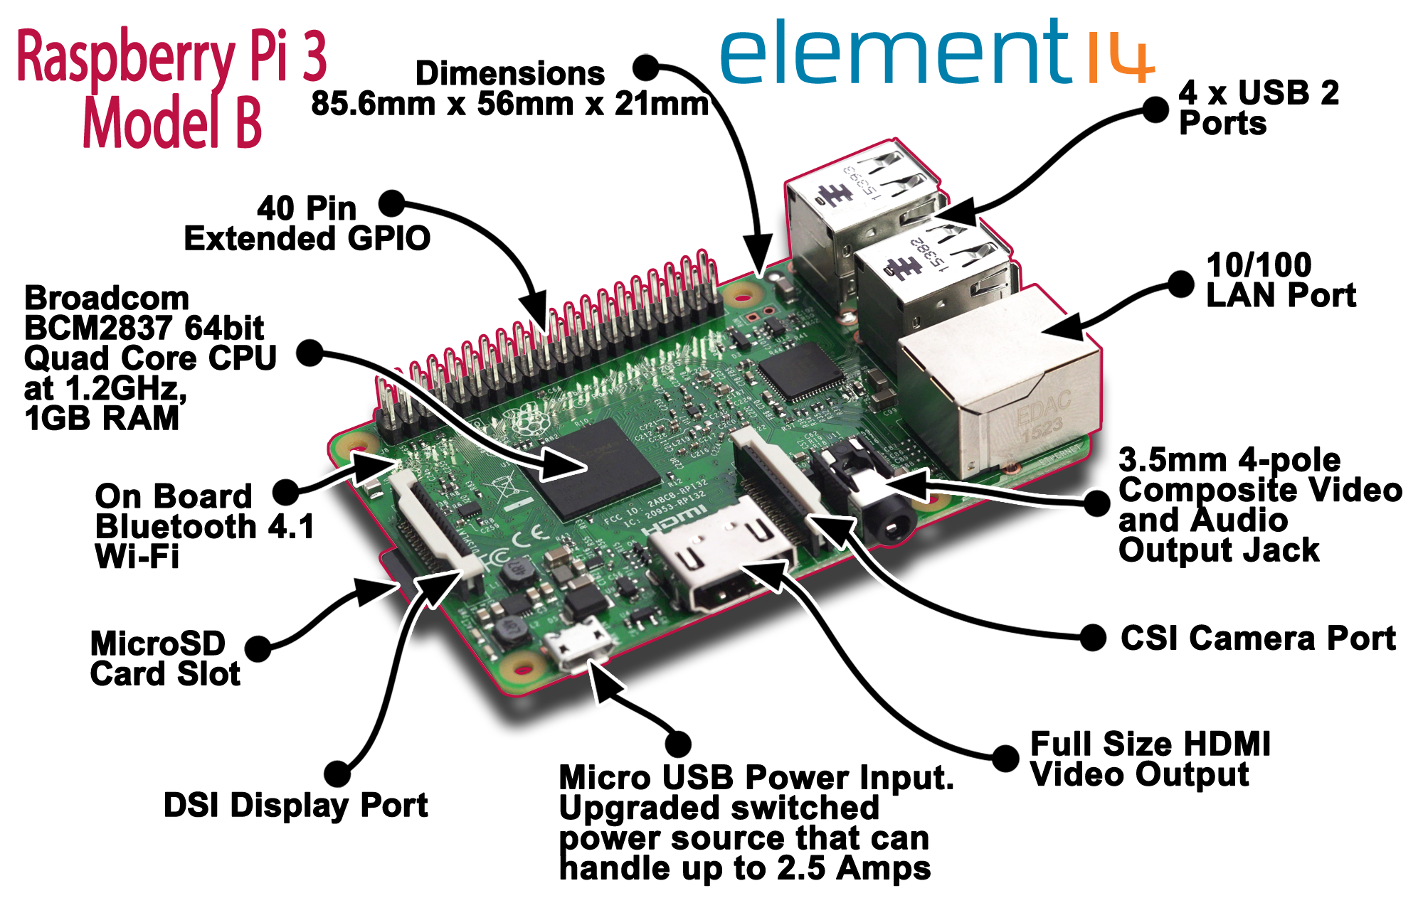

Slide 11
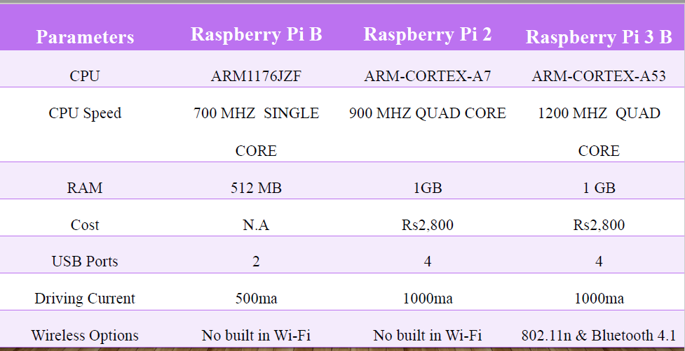
Comparison between different Models

Slide 12
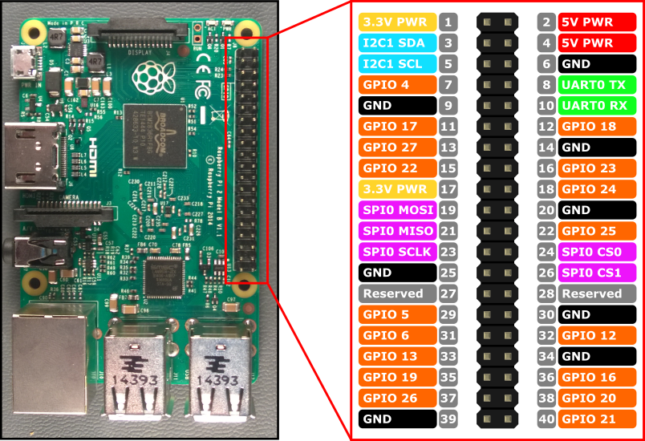
GPIO Connectors

Slide 13
Operating System
Raspbian
Fedora
Ubuntu Mate
OSMC(open source media center)
ArchLinux ARM
Windows 10 On Raspberry Pi2

Slide 14
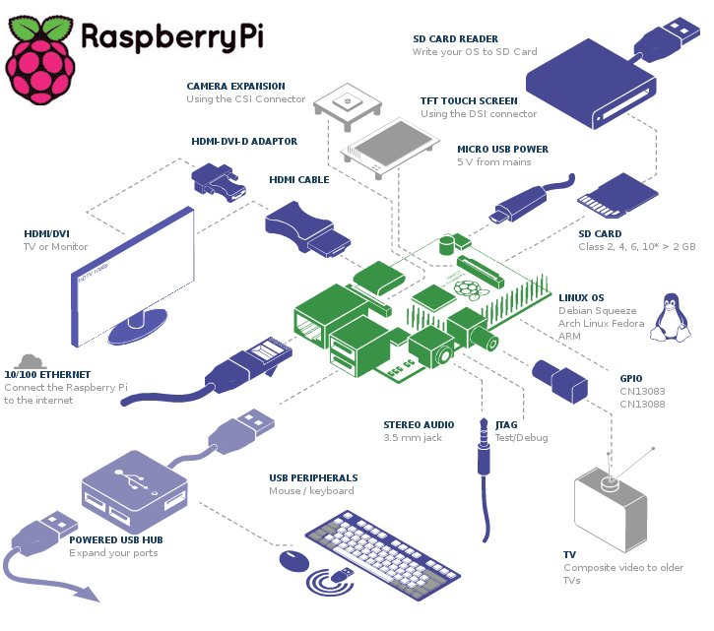
How to make it work!

Slide 15
Programming
By default, supporting Python as the educational language.
Any language which will compile for ARMv6 can be used with the Raspberry Pi.

Slide 16
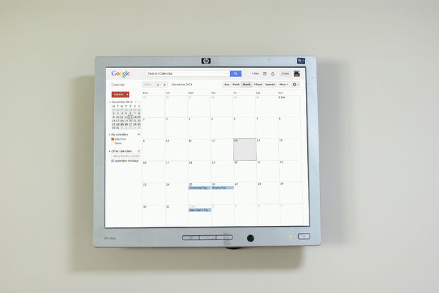
Applications
Raspberry Pi Wall Mounted Google Calendar – On Instructables

Slide 17
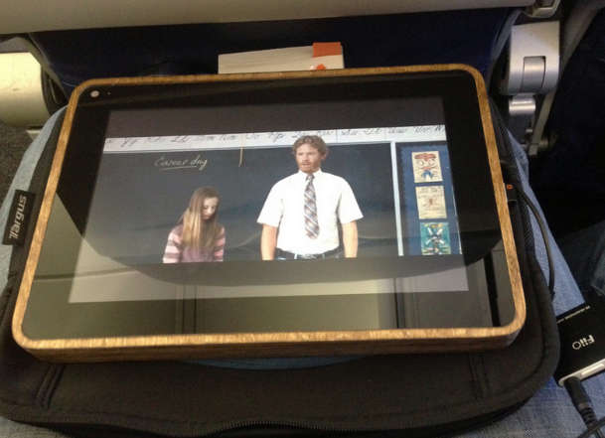
Applications
PiPad: Tablet Using Raspberry Pi.

Slide 18
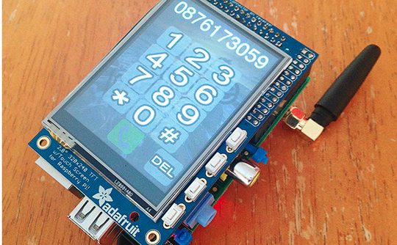
Applications
PiPhone : Using Raspberry Pi.

Slide 19
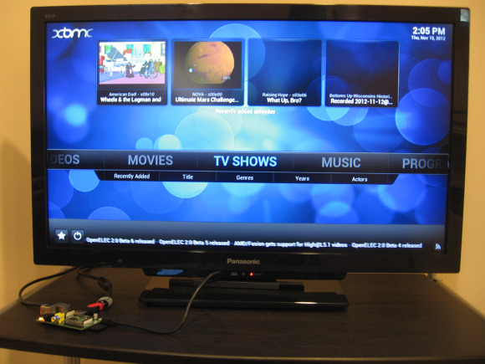
Applications
Pi as a Media Centre : Convert Your TV Into Smart TV.

Slide 20
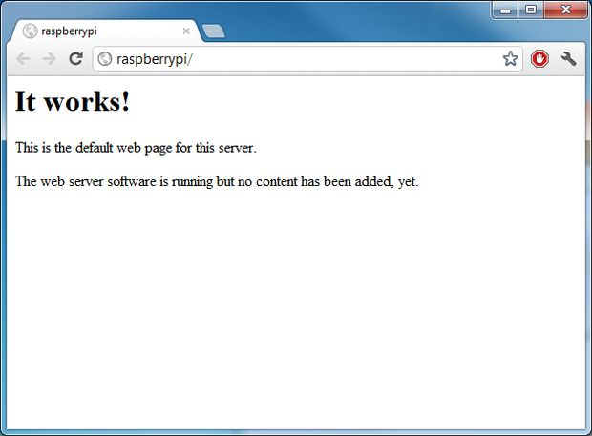
Applications
Running a Web server on Raspberry Pi

Slide 21

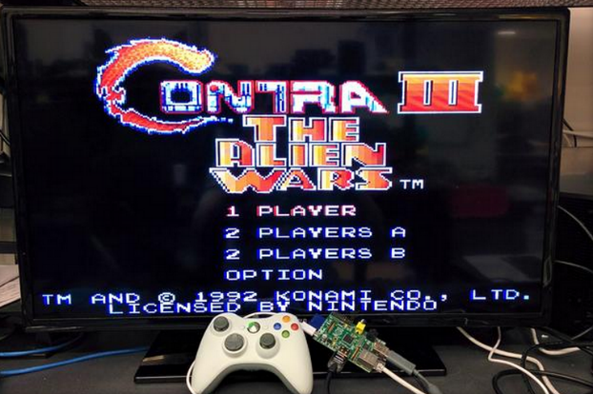

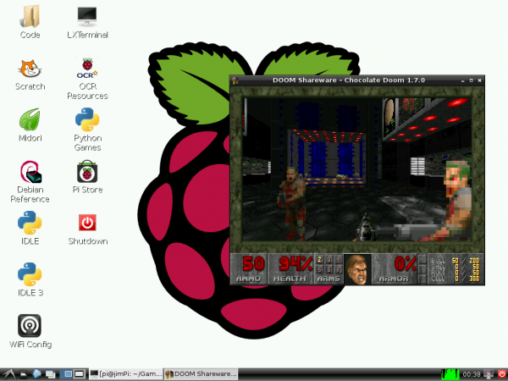
Applications
Games on Raspberry Pi.

Slide 22
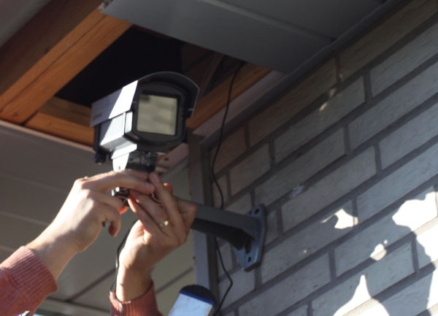
Applications
Low Cost HD Surveillance Camera

Slide 23
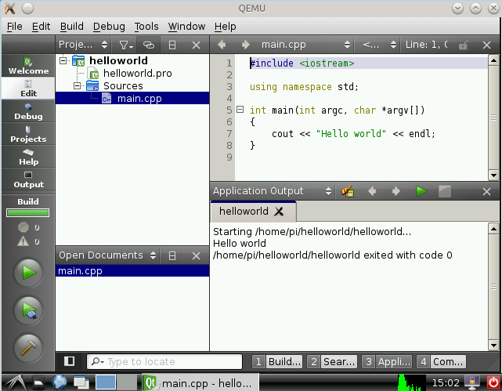
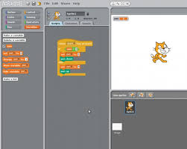
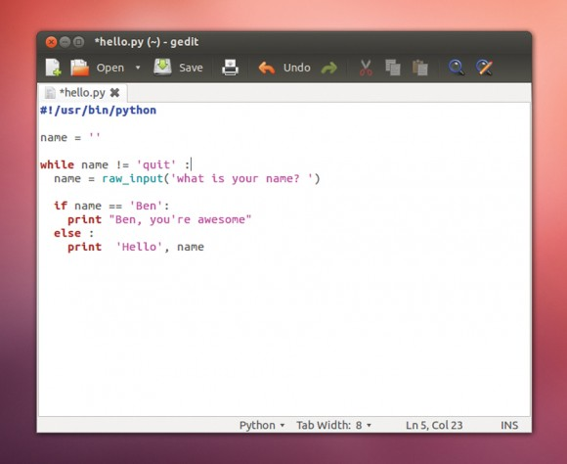
Applications
Learning Programming : Learn Python, C/C++, Java, Ruby, Basic, etc.

Slide 24
INSTALLING OPERATING SYSTEM IMAGES USING WINDOWS
Insert the SD card into your SD card reader and check which drive letter was assigned. You can easily see the drive letter, such as G:, by looking in the left column of Windows Explorer. You can use the SD card slot if you have one, or a cheap SD adapter in a USB port.
Download the Win32DiskImager utility from the Sourceforge Project page as a zip file; you can run this from a USB drive.
Extract the executable from the zip file and run the Win32DiskImager utility; you may need to run this as administrator. Right-click on the file, and select Run as administrator.
Select the image file you extracted earlier.
Select the drive letter of the SD card in the device box. Be careful to select the correct drive; if you get the wrong one you can destroy the data on your computer's hard disk! If you are using an SD card slot in your computer and can't see the drive in the Win32DiskImager window, try using an external SD adapter.
Click Write and wait for the write to complete.
Exit the imager and eject the SD card.

Slide 25
Working with a USB webcam
USB webcams are great to capture images and videos. Raspberry Pi supports most USB webcams.
Attach your USB webcam to Raspberry Pi through the USB port on Pi and run the lsusb command in the terminal. This command lists all the USB devices connected to the computer.
Then, install the fswebcam utility with the sudo apt-get install fswebcam command. Once the installation is done, you can use the following command to capture the image:
fswebcam -r 1280x960 --no-banner ~/book/output/camtest.jpg

Slide 26
Working with a webcam using OpenCV
import cv2
# initialize the camera
cam = cv2.VideoCapture(0)
ret, image = cam.read()
if ret:
cv2.imshow('SnapshotTest',image)
cv2.waitKey(0)
cv2.destroyWindow('SnapshotTest')
cv2.imwrite('/home/pi/book/output/SnapshotTest.jpg',image)
cam.release()

Slide 27
live video stream from a webcam
import cv2
cam = cv2.VideoCapture(0)
print 'Default Resolution is ' + str(int(cam.get(3))) + 'x' + str(int(cam.get(4)))
w=1024, h=768
cam.set(3,w)
cam.set(4,h)
print 'Now resolution is set to ' + str(w) + 'x' + str(h)
while(True):
# Capture frame-by-frame
ret, frame = cam.read()
# Display the resulting frame
cv2.imshow('Video Test',frame)
# Wait for Escape Key
if cv2.waitKey(1) == 27 :
break
# When everything done, release the capture
cam.release()
cv2.destroyAllWindows()

Slide 28
Working with the Pi camera module
This camera module is specially manufactured for Raspberry Pi and works with all the available models. You will need to connect the camera module to the CSI port, located behind the Ethernet port, and activate the camera using the raspi-config utility.
To capture images and videos using the Raspberry Pi camera module, we need to use the raspistill and raspivid utilities.
To capture an image, run following command:
raspistill -o cam_module_pic.jpg
This will capture and save the image with the name cam_module_pic.jpg.
To capture a 20-second video with the camera module, run the following command:
Raspivid –o test.avi –t 20000

Slide 29
picamera and OpenCV
The following code demonstrates the use of picamera with OpenCV; it shows a preview for 3 seconds, captures an image, and displays it on screen using cv2.imshow():
import picamera
import picamera.array
import time
import cv2
with picamera.PiCamera() as camera:
rawCap=picamera.array.PiRGBArray(camera)
camera.start_preview()
time.sleep(3)
camera.capture(rawCap,format="bgr")
image=rawCap.array
cv2.imshow("Test",image)
cv2.waitKey(0)
cv2.destroyAllWindows()

Slide 30
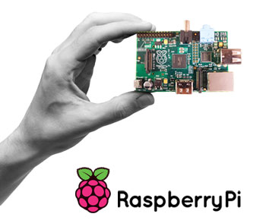
THANK YOU

